Slide 1
INVENTORY MANAGEMENT SYSTEM

Slide 2
Agenda
Menu
Add item
View Item
Delete item
Outputs

Slide 3
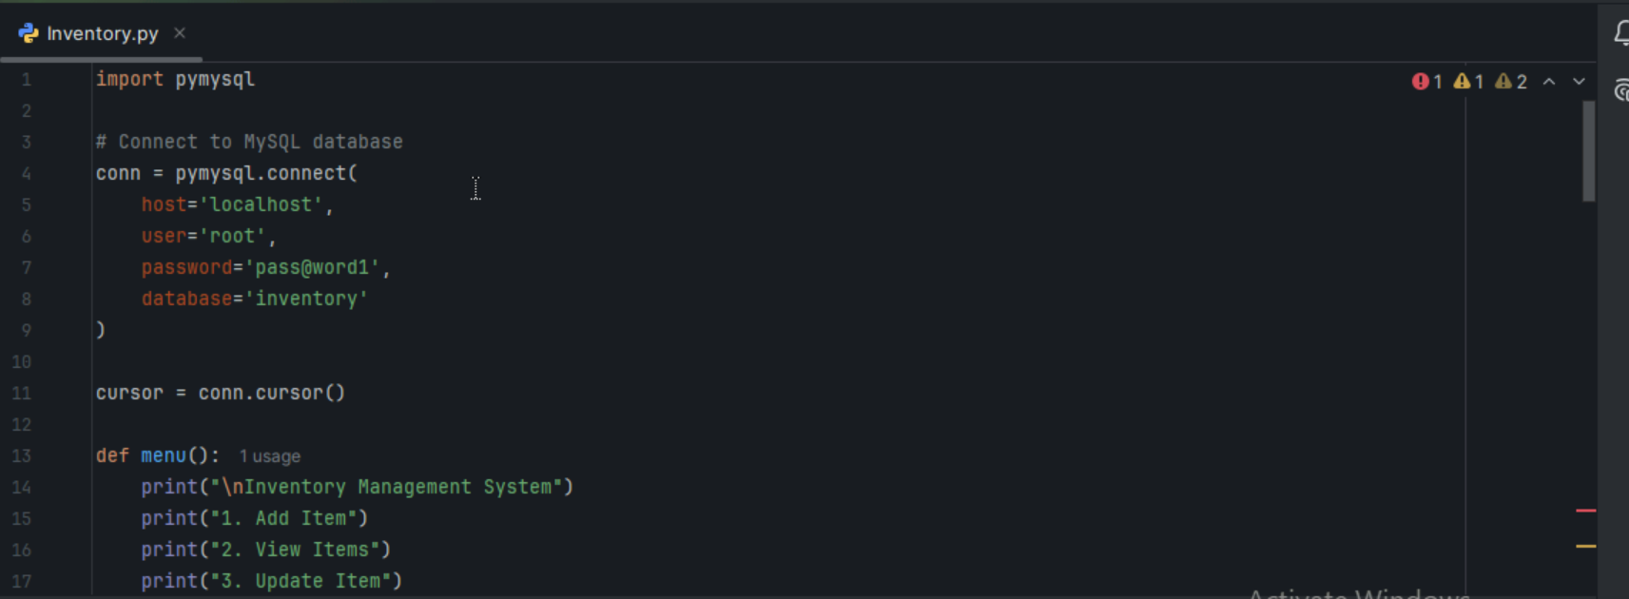

Slide 4
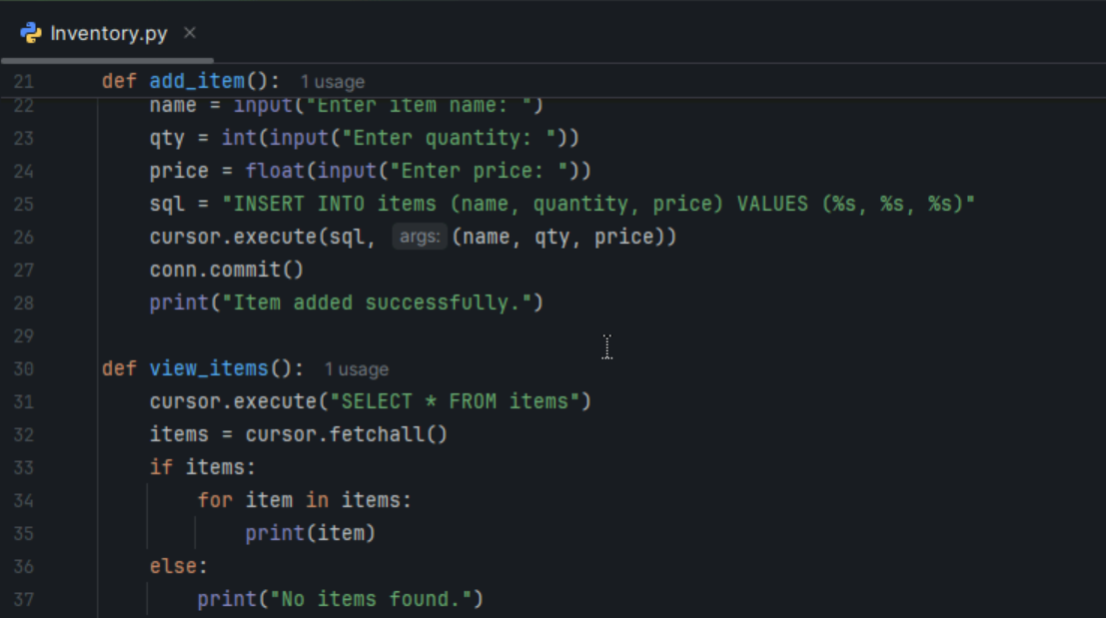

Slide 5
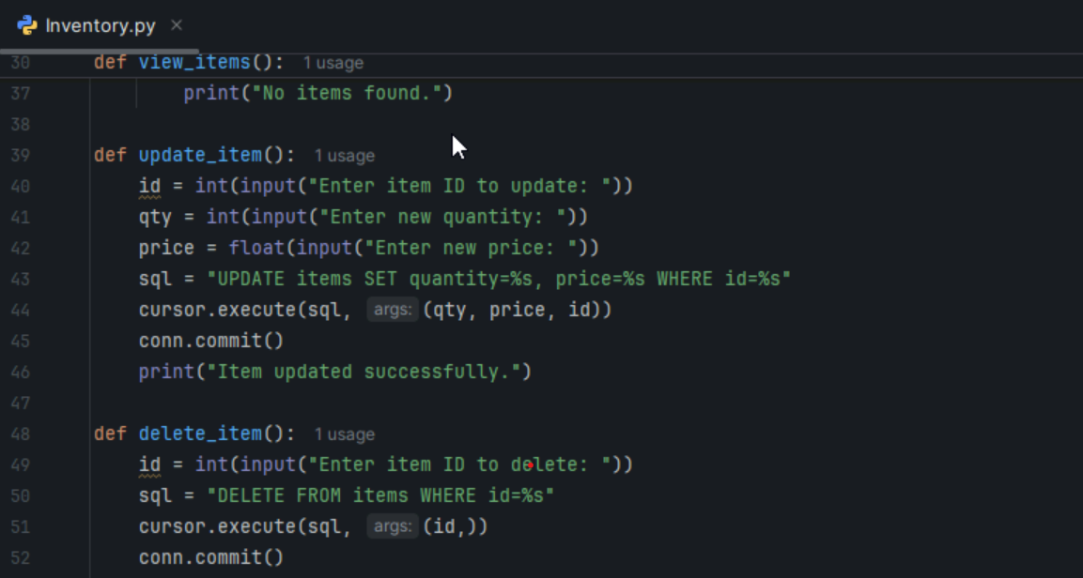

Slide 6
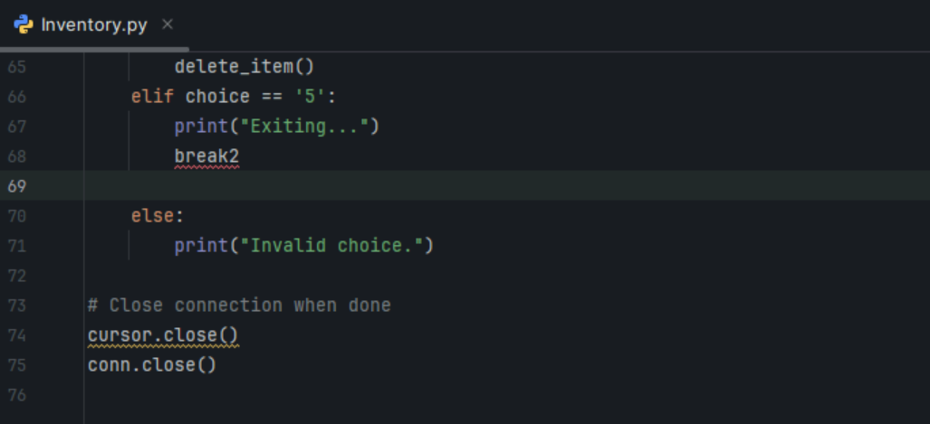

Slide 7
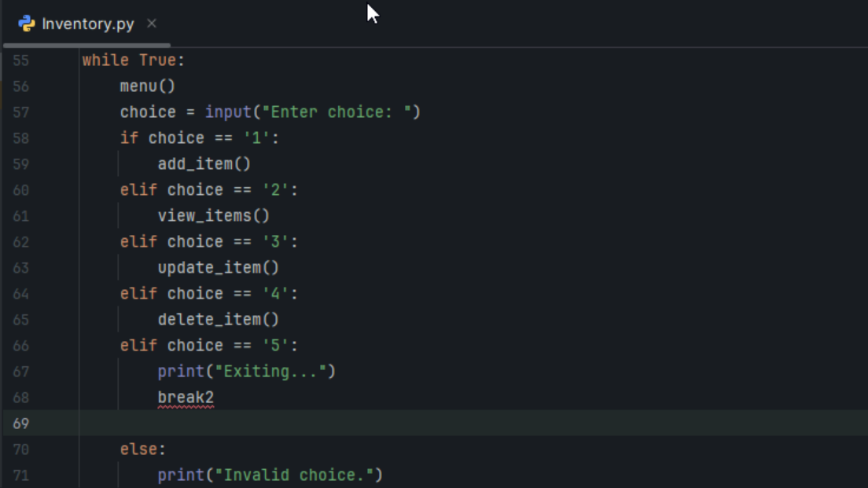

Slide 8
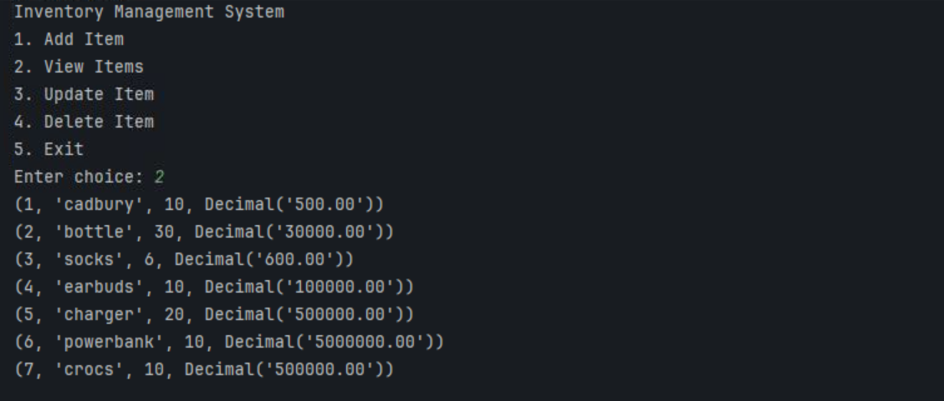
Output

Slide 9
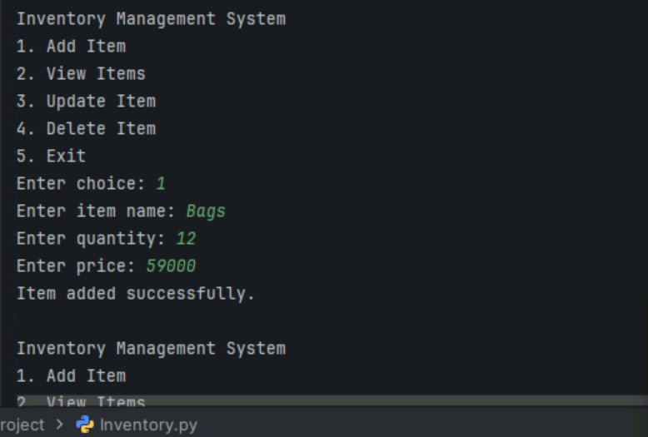
Output

Slide 10
Output

Slide 11
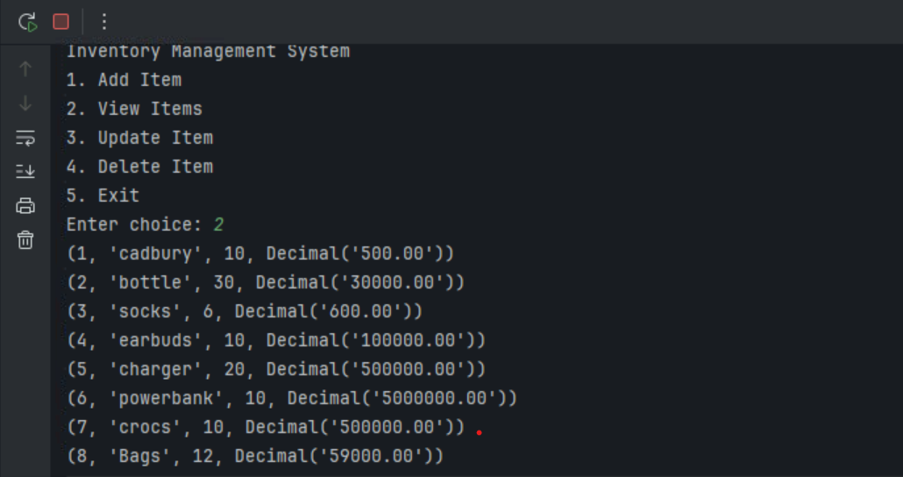
Output

Slide 12
Output

Slide 13
Thank you

